Slide 1

SwiftCabSG
By Team Matrix

Slide 2
Backstory

Slide 3
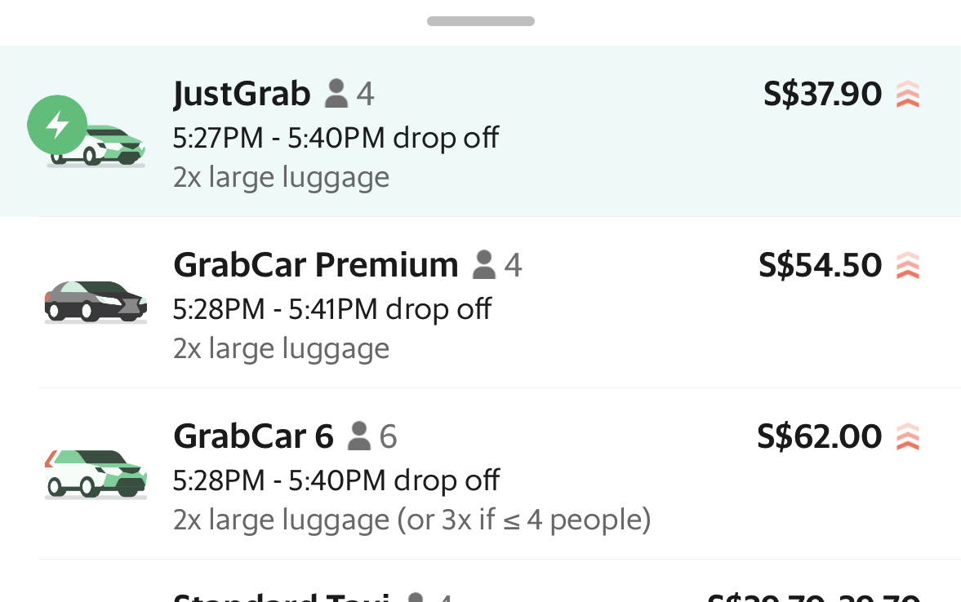


Slide 4
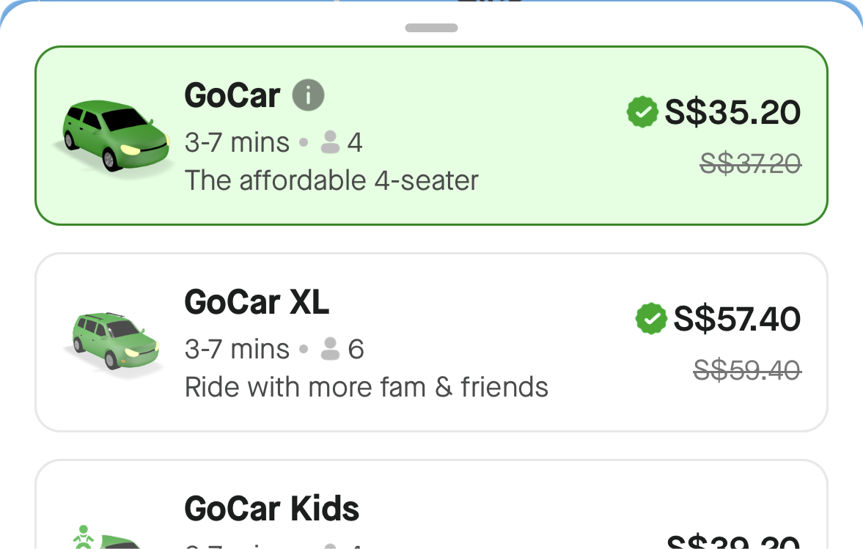


Slide 5
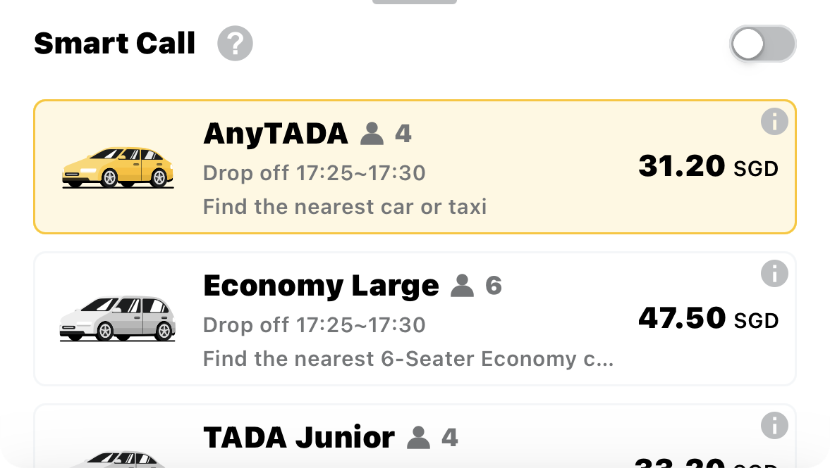


Slide 6
Concept
Different taxi services offer various taxi fares

Slide 7
Concept
Seamlessly compare prices in a single platform and book
VS
VS

Slide 8
Our Solution

Slide 9
Target Audience
Busy commuters who have to travel to and fro everyday
People who are in a rush and need to make a quick and cost-sensitive decisions

Slide 10
Find affordable rides effortlessly

Slide 11
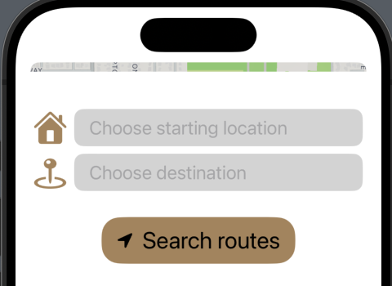
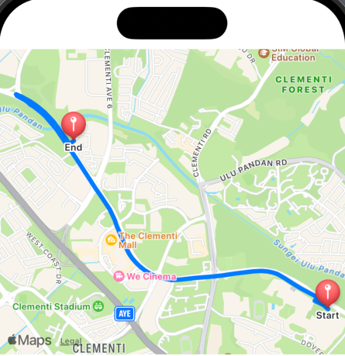
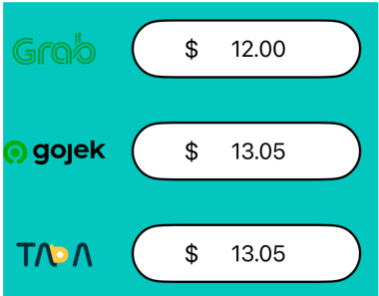
Efficient And Simple
Simply type where you want to go
Available rides will be arranged from cheapest to priciest
The route for you

Slide 12
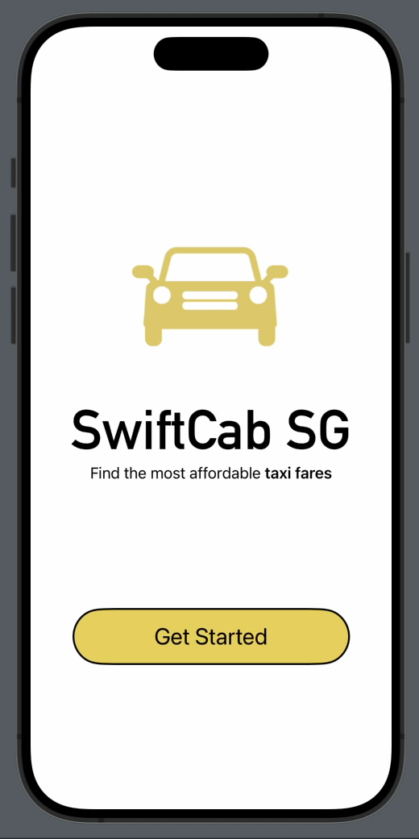
Application Live Demo

Slide 13





Cost
Savings
different
apps
into
one
platform
Booking taxi
SwiftCabSG
Widgetsmith
􁅗
VS
VS
Less
Time-consuming

Slide 14

Our Team
Steve, Shanna, Ashley, Vibin

